Slide 1
Steps to Transformative Change: Diversity, Equity, and Energy
Wisconsin Academy of Sciences, Arts & Letters
Environmental Breakfast Series
October 21st, 2020

Slide 2
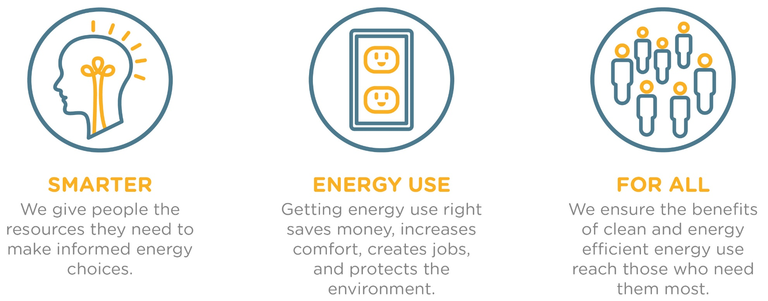
Our Mission
We promote smarter energy use for all.
Notes:
Elevate Energy’s Mission

Slide 3
Impact Statement & Theory of Change
Intended Impact Statement
Theory of Change
By 2024 Elevate will catalyze sustainable development impacting over 1M people who can benefit from it most in the communities where we live, work and play.
In the process we will be innovative partners in the development of a just transition to a built environment which restores environmental justice, increases health, builds equity, generates intergenerational wealth and combats climate change.
Elevate Energy will BUILD a diverse and inclusive work environment powered by integrated systems which enable our customers, partners and our teams to do their most ambitious and effective work.
We will DELIVER people-centered programs which simultaneously reduce household costs, increase resident health, and improve building performance.
... and TRANSFORM the communities we work in by closing the gap between theory and practice with policies and innovations that promote equitable and just solutions to climate change.
Notes:
How it fits

Slide 4
Integrating DREI into Elevate’s organization and work
Challenge Areas
  Human Resources
  Implicit Bias
Opportunity Areas
  Use of shared language amongst multigenerational staff
  Integrating DREI values into community work
  Create DREI specific policies
  Hiring and continued support of people with nondominant identities
  Shift in organization culture
  Ongoing organization education

Slide 5
RECS 2015: 30% of Americans experience energy insecurity
https://www.eia.gov/consumption/residential/reports/2015/energybills/
RECS question | Prevalence (East North Central region)
Reducing or forgoing food or medicine to pay energy costs | 20%
Received disconnection notice | 9.4%
Kept home at unhealthy or unsafe temperature | 15%
Unable to use heating equipment * | 4.4%
Unable to use cooling equipment * | 4.4%
Any of the above | 30%
* Due to equipment broken and can’t get it repaired, or a disconnection due to nonpayment

Slide 6
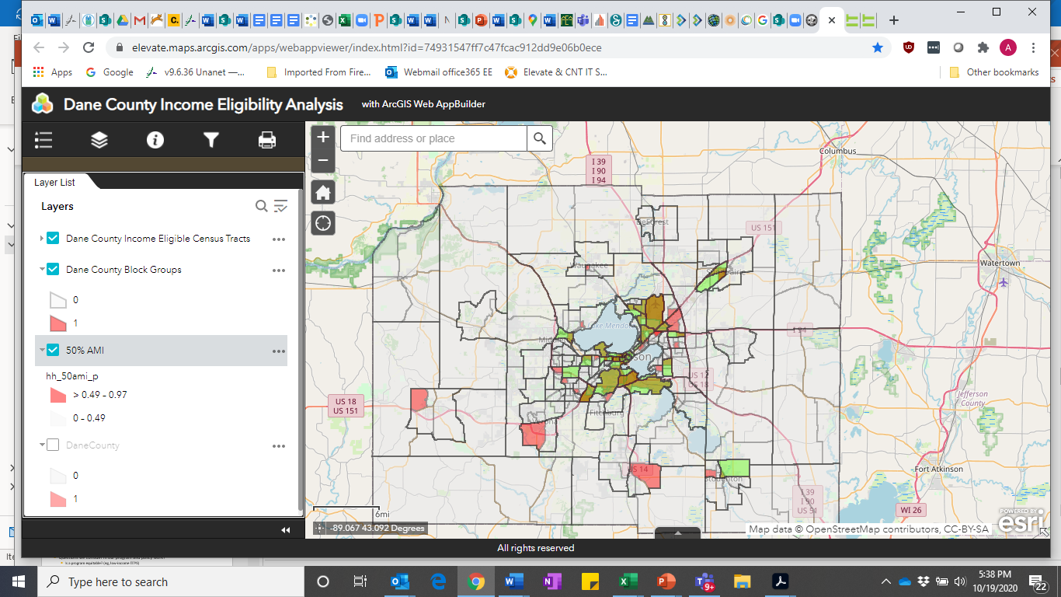
Why is equity important in our work?
Energy insecurity
Healthy buildings
Water affordability
High road jobs
Clean energy economy

Slide 7
Questions & Discussion
Wisconsin Academy of Sciences, Arts & Letters
Environmental Breakfast Series
October 21st, 2020

Slide 8
Centering equity in our work
Questions we consider in our program and policy work?
  Is a program equitable? (eg, low-income energy efficiency)
  Is a policy equitable? (eg, Future Energy Jobs Act)
  Is a system equitable? (eg, energy distribution system)
Notes:
EJ
Evidence that there are really harmful disproportionate effects on particular groups (communities of color; developing countries; etc etc)
EJ doctrine:
Preventing the disproportional imposition of env. risks, harms, and burdens
AND
Ensuring proportionate distribution of environmental benefits and amenities
Target universalism
Targeted universalism rejects a blanket universal which is likely to be indifferent to the reality that different groups are situated differently relative to the institutions and resources of society. It also rejects the claim of formal equality that would treat all people the same as a way of denying difference.
Targeting within universalism means identifying a problem, particularly one suffered by marginalized people, proposing a solution, and then broadening its scope to cover as many people as possible. It sees marginalized populations in American society as the canary in the coal mine, to borrow a metaphor developed by Lani Guinier and Gerald Torres. It recognizes that problems faced by particular segments of American society are problems that could spill over into the lives of everyone, just as the Lower Ninth Ward was not the only part of New Orleans to suffer in the wake of Katrina.
Targeting within universalism means being proactive and goal-oriented about achievable outcomes… It is critical that targeted universal policies set clear goals and use mechanisms to closely monitor and correct for negative feedback loops and other resistance to achieve those goals.
(http://www.prrac.org/full_text.php?text_id=1223&item_id=11577&newsletter_id=104&header=Miscellaneous&kc=1)
Policy Link
“Just and fair inclusion into a society in which all can participate, prosper, and reach their full potential. Unlocking the promise of the nation by unleashing the promise in us all.”
(http://www.policylink.org/about/equity-manifesto)

Slide 9
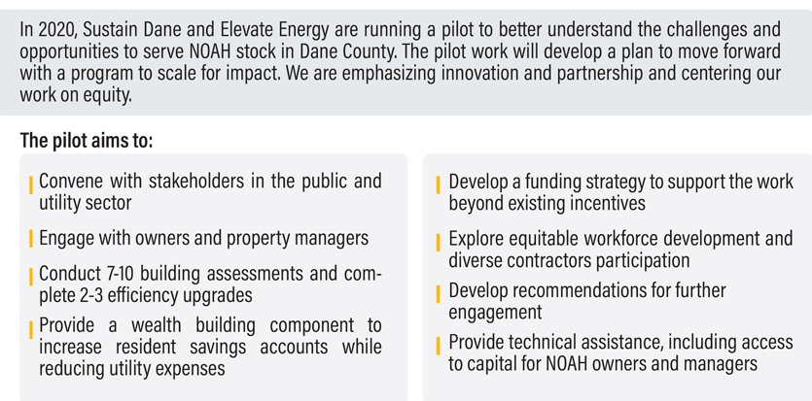
Dane County Naturally Occurring Affordable Housing Initiative

Slide 10
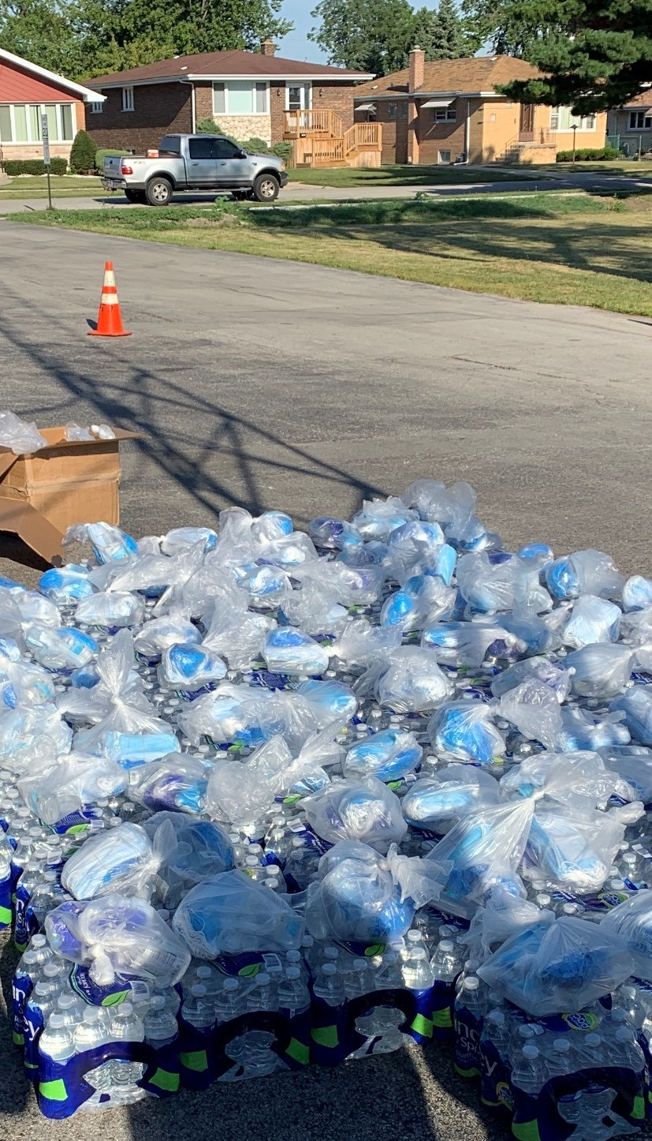
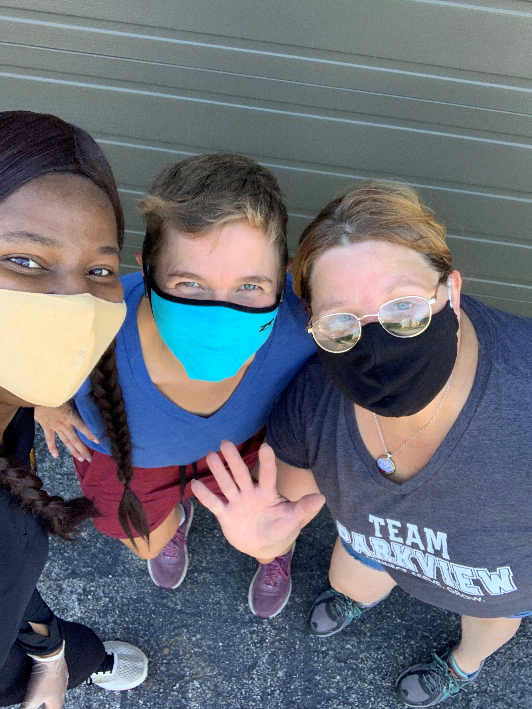
Emphasis on Community Service
Rental and/or utility bill assistance to over 250 families in Illinois, Michigan, and Wisconsin
Over 200,000 bottles of water distributed in communities in need of safe drinking water due to water utility shut-offs
Groceries to over 200 seniors

Slide 11
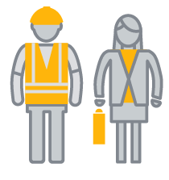
Emphasis on workforce and diverse contractors
Provide access to utility energy efficiency trade ally programs to disadvantaged contractors
Provide training in back office support (eg: invoicing), marketing and outreach. Assist with access to trade ally programs and M/W/V/D business certifications - 20 contractors graduated in 2019
Provide solar installation training to 105 trainees
Notes:
Problem:
The energy system is transforming…clean energy sources are coming online, utilities (some) are changing their business models, grassroots movements are pushing for more control of how energy is owned, sourced, and distributed.
This system has been designed and managed (like many institutions) to benefit those with power. This has resulted in an unequal distribution of energy benefits, as is well documented by Elevate and others.
---
Market space is growing, and M/WBE are not engaged at this point.
Data on

Slide 12
Emphasis on Internal Operations
DREI Committee
  Use of shared language amongst multigenerational staff
  Ongoing organizational education and training
Shifts in organization culture to address implicit bias
Hiring and continued support of people with nondominant identities
Integrating DREI principles into our projects
  Emphasis on diverse contractors
  Increased focus on community service

Slide 13

Thank You!
Abigail Corso, P.E. LEED AP O+M
Abigail.Corso@elevateenergy.org
773.321.2663
Delmar Gillus
Delmar.Gillus@elevateenergy.org
773.269.4088

Slide 14
Appendix- Slides not for use or distribution unless needed

Slide 15
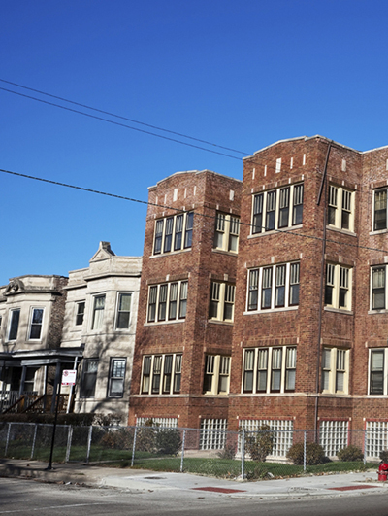
Energy Efficient Buildings
Multifamily buildings:
More than 50,000 units retrofitted
More than 8 million therms and 22 million kWh saved
Leveraged financing through Community Investment Corporation
Typical savings of 30%

Slide 16
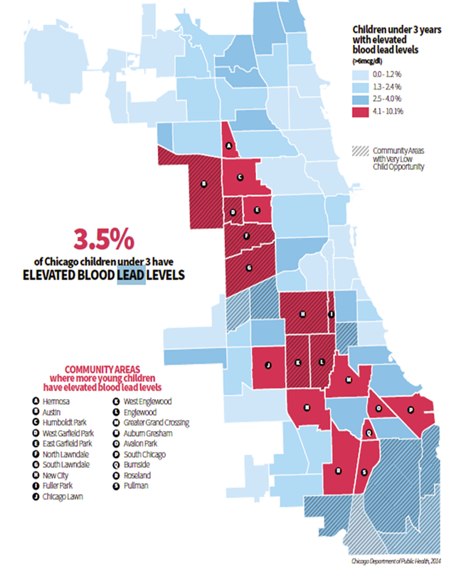
Healthy Homes
Implementing a preventative lead abatement program to further assist in reducing childhood lead poisoning in Chicago
  Reduce childhood lead exposure in Chicago/participating homes
  Increase number of homes free of lead hazards
  Provide education and resources to homeowners

Slide 17
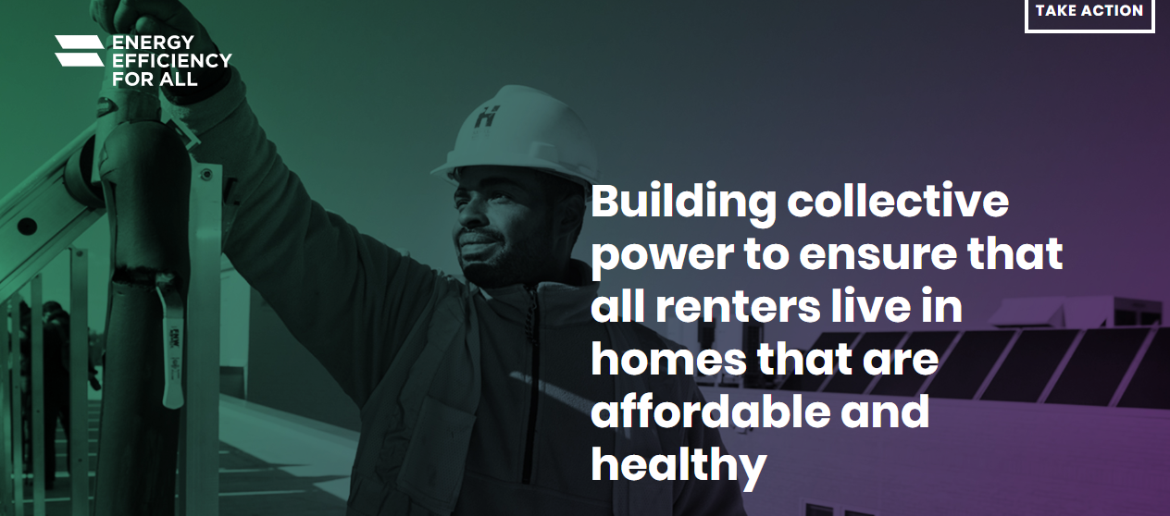
Energy Efficiency for All
Over 60 participating organizations
12 state coalitions but working nationally
Emphasis on preserving and improving affordable housing
Results are over $500M in new utility program dollars

Slide 18
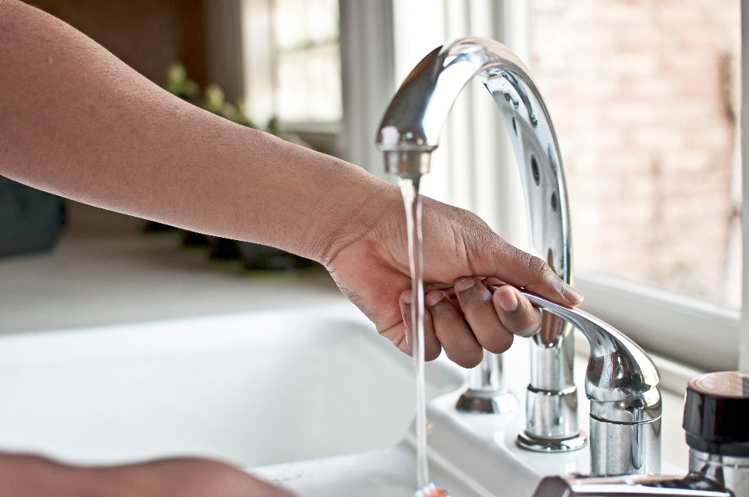
Lead in Water
Reduce exposure to lead risks in drinking water
Pilot project to test for lead in water at childcare centers and remove significant sources of lead
Research to understand homeowner steps to remove LSLs and the status of lead service line replacement programs

Slide 19
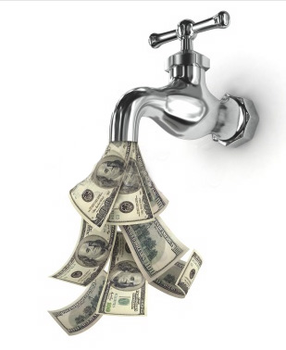
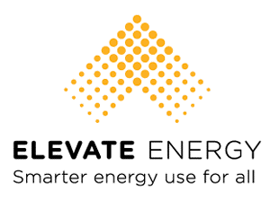


Water Affordability Research Initiative
Exploring the extent to which communities in Northeastern, IL are facing water affordability challenges, and
Identifying opportunities to address these concerns
Early research findings: water affordability is an issue across the entire region – not just in areas where the MHI is low
Notes:
Many residents in low-income and vulnerable communities are struggling to pay their water bills leading to high water debt and a high number of shut offs. And by 2022, as many as one third of all U.S. households could find their water bills unaffordable.
Elevate is undergoing a multiagency research initiative to explore the extent to which households in Northeastern IL are indeed facing water affordability issues, and if so, where. We are also researching what practices or tools might be available to address this issue.
In order to attain a more nuanced picture of water affordability in the northeastern Illinois region, our research is looking at issues of affordability at the census tract level in 200+ communities, rather than only explore issues of affordability by looking at municipal-level household incomes.
Our research is wrapping up this year and will be widely available to the public – including on an interactive water affordability dashboard – in 2020.

Slide 20
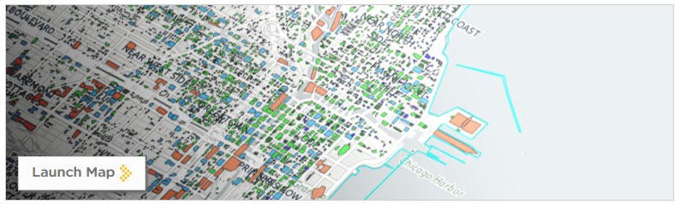
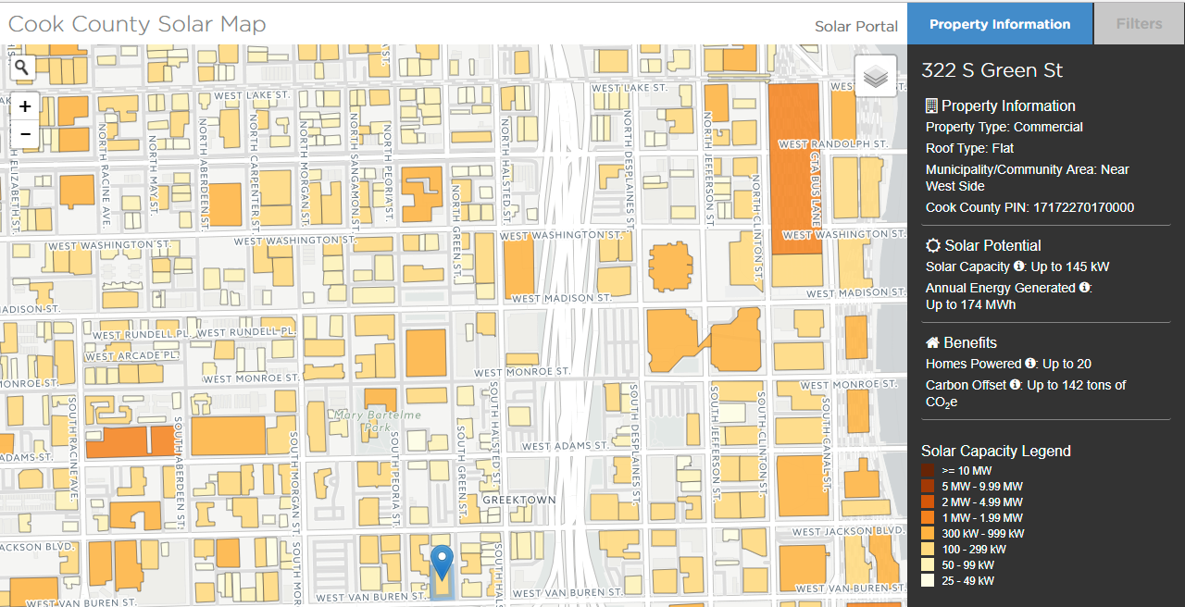


Community Solar
GIS Mapping Tool that shows community solar capacity potential for every building and land parcel in Cook County
Facilitates community solar development by giving community leaders and developers a tool to identify suitable sites in Cook County.
Search by:
  System Size
  Interconnection probability
  Property Type
  Roof Type
  Municipality/Neighborhood
https://www.elevateenergy.org/cc-solar-map/

